Slide 1


ENIGMATIC EXAMPLE #1
PRIYANSHU SAGAR

Slide 2

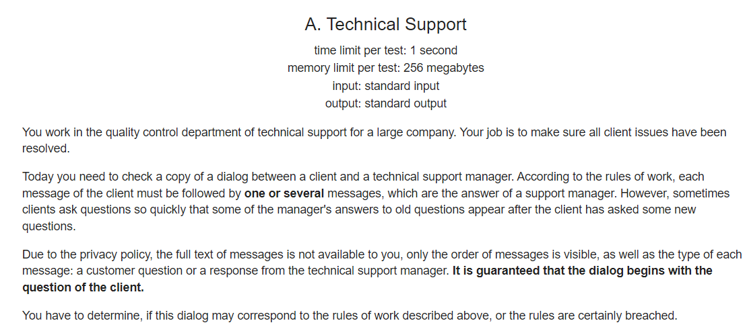
PROBLEM STATEMENT(S)

Slide 3

A Suggested tackle approach…

Slide 4



BEFORE GETTING INTO…
Let us get familiar with some nomenclatures:
We will use Q to denote customer questions and A for response from support manager.
We will use S to denote the accepted string which contains the chat between client and support manager.
‘i’ will denote index of S where ‘i’ goes from 0 to len(S).
Do n

Slide 5
DEDUCTIONS…
3.only the order of messages is visible, as well as the type of each message: a customer question or a response from the technical support manager.
An example of a chat can be: ‘QAQAQAQA’.
1.According to the rules of work, each message of the client must be followed by one or several messages.
This hints us that a combination of S=QAQAAA is acceptable. Thus, the condition of S.count(‘Q’)==S.count(‘A’) may not always give desired results.

Slide 6
2.sometimes clients ask questions so quickly that some of the manager’s answers to old questions appear after the client has asked some new questions.
This, in aid with previous, tells us that a combination of S=QQAAA is acceptable. Thus, the condition of checking if S[i]==‘Q’ then S[i+1]==‘A’ is inappropriate.
4.It is guaranteed that the dialog begins with the question of the client.
This may seem obvious now, but we must take special care in not making any presumptions.
5.have to determine, if this dialog may correspond to the rules of work described above, or the rules are certainly breached.
We have our question/task at hand, let’s start brainstorming! But before that...

Slide 7

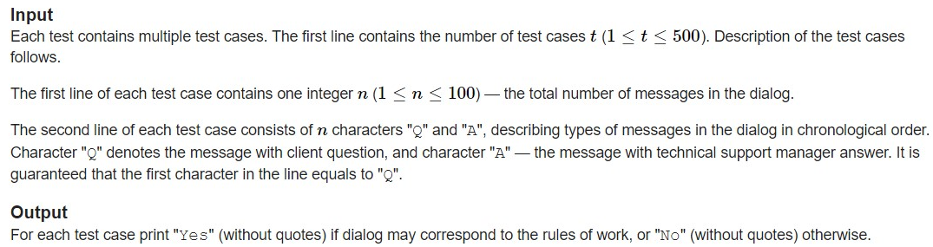
INSTRUCTIONS
At our current level, we shouldn’t bother about the ranges depicted which eventually gets us into the concepts of space and time complexity. Exploit the absence of restrictions and code recklessly!

Slide 8
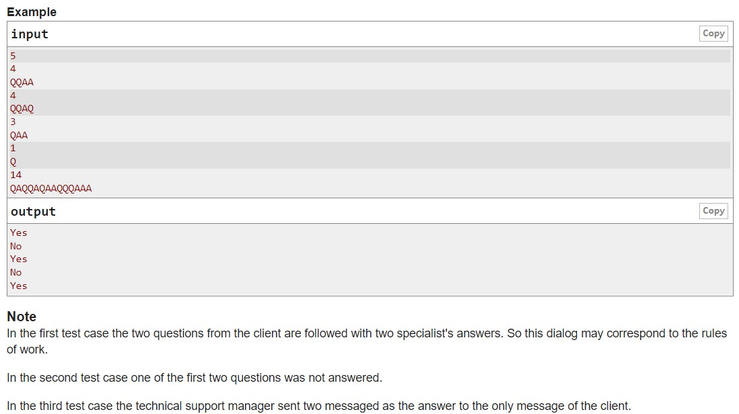













Exempli GRETIA
G
E
T?
S
E
T,
G
O!
Number of test cases
1
Number of characters
2
3
4
5

Slide 9
A POSSIBLE GUESS… and a point to ponder
QUERY
I can’t give S.count(‘Q’)==S.count(‘A’), but won’t S.count(‘Q’)<=S.count(‘A’) serve the purpose?
i.e., number of occurrences of ‘Q’ or number of questions must be lesser than or equal to number of occurrences of ‘A’ or number of answers. Simple enough, right?

Slide 10
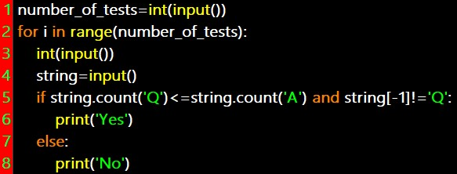


CODE FOR THE last IDEA…

Slide 11
FELL FOR THE RED HERRING?
Consider the following inputs.
INPUT-1:
‘QAAQ
Even after putting and condition and ensuring s[-1]!=‘Q’…
Think of this:
INPUT-2:
‘QAAAQQA’
A query cannot be resolved before it’s asked, hence we need to think differently.

Slide 12
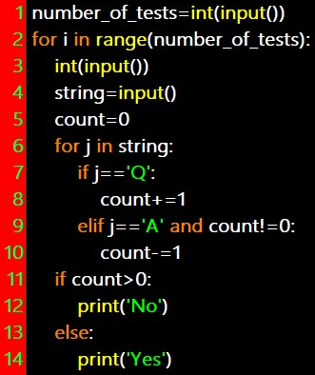
MOULDING a LOGIC into code…

Slide 13
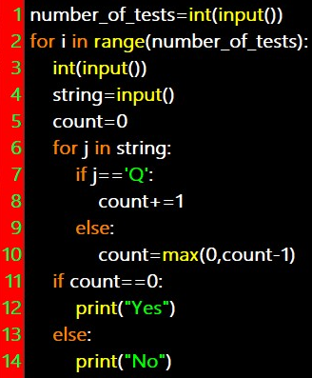
Alternatively…

Slide 14
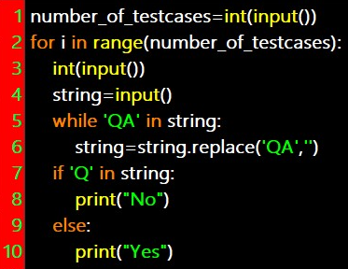
AROUND…
WAY
WITTY

Slide 15





Introduction to platformS
CodeChef
GeekforGeeks
Codeforces
HackerRank
LeetCode

